Slide 1

Book Recommendation System
Presented By :-
Rohit Tiwari (2100520109002)
Shivam Pandey (2000520100061)
Samarth Gautam (2000520100050)

Slide 2
Agenda
Introduction
Problem Statement
Methedology
Implementation
Conclusion
Book recommendation System

Slide 3
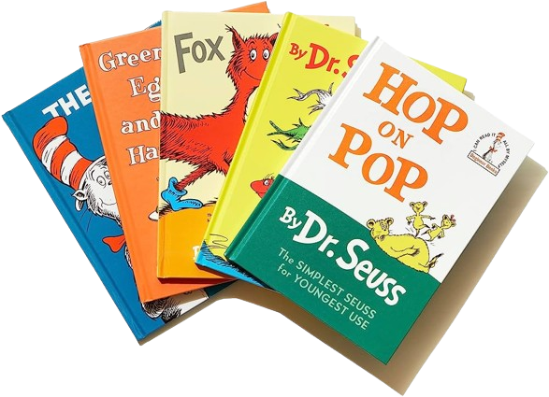
Introduction
In a world with millions of books available, finding the right one can be overwhelming. To address this, viewers may rate books to help others make informed decisions. However, exaggerated descriptions can mislead viewers and result in inaccurate recommendations. This project aims to solve this problem. By leveraging the existing methodologies and researches, we’re trying to develop a quick and intuitive book recommendation system to help users find the right book efficiently.

Slide 4
Problem Statement
To develop an effective book recommendation system to help users navigate through a vast array of books and make informed choices.
Aim and Objective
Research on how to make an effective recommendation
Research on background study of similar systems that intend to solve the same problem.
To develop a system to recommend books to the user

Slide 5
Methodology
We will give a detail on the development steps and the process of development cycle.
Data Sources and Preprocessing
Algorithm Development Process
Web Application Development Process
Glimpse of Website
Conclusion

Slide 6
Data Sources and Preprocessing
We have user the Book-Crossing Dataset which is available on Kaggle
The Book-Crossing Dataset comprises 3 files:
Users
Books
Ratings

Slide 7
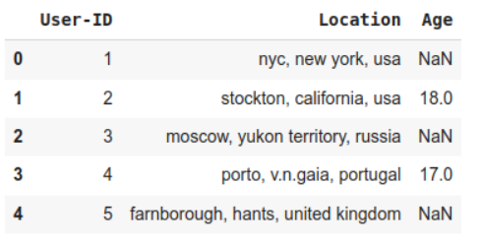
Data Sources
Users
Users file contain User-ID, Location and Age
Fields in which data is not available is contains NULL-Values

Slide 8
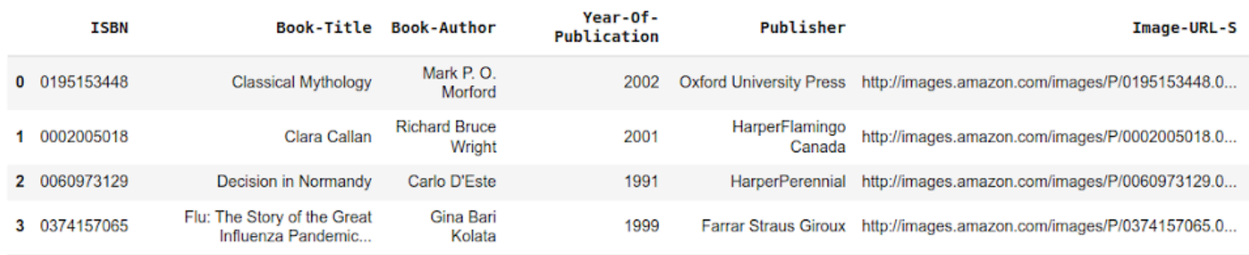
Data Sources
Books
Books are identified by their ISBNs.
It also contains Title, Author, Year-of-Publication and Publisher

Slide 9
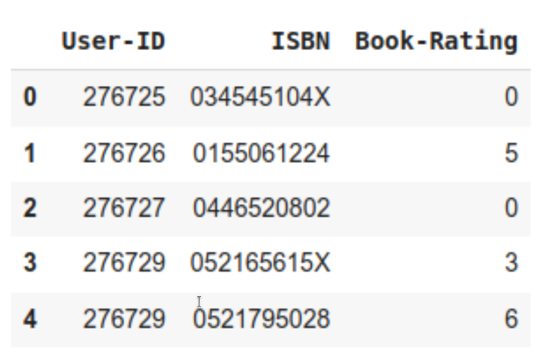
Data Sources
Ratings
Contains the Book Rating Information
Expressed on a scale of (1-10)

Slide 10
Data Sources
Dimensions of Dataset:
Book_df shape is (271360, 8)
Ratings_df shape is (1149780, 3)
Users_df shape is (278858, 3)

Slide 11
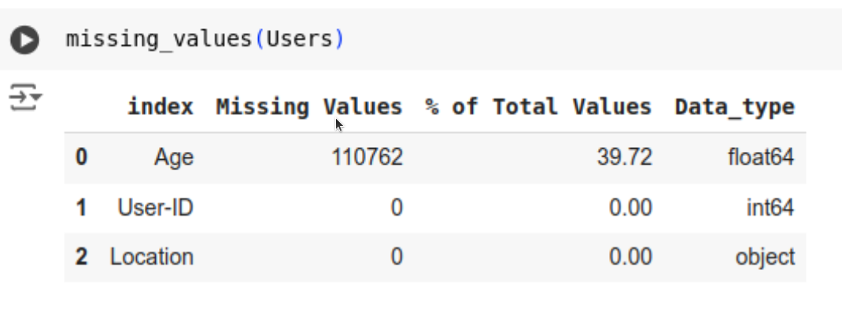
Data Preprocessing
Users Table:
Missing Values
Age column has 39.72% missing values

Slide 12
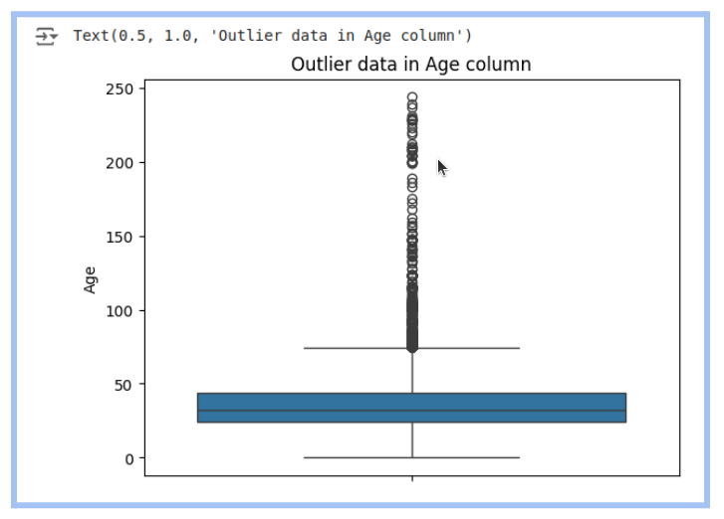
Data Preprocessing
Users Table:
Outliers in the Age Group
Age value's below 5 and above 100
do not make much sense for our
book rating case, so after replacing these
by NaNs we have a total 112010 Null Values
in the Age Column.

Slide 13
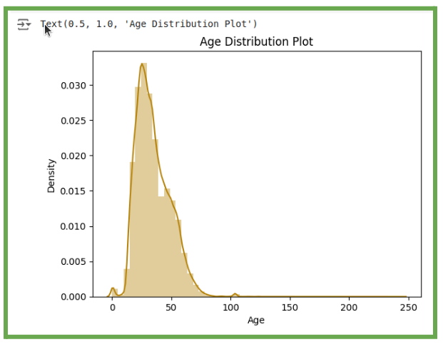
Data Preprocessing
Users Table:
Age has positive Skewness (right tail) so we can
use median to fill Nan values, but for this we
don't like to fill Nan values just for one range
of age. To handle this we'll use the country
column to fill Nan.

Slide 14
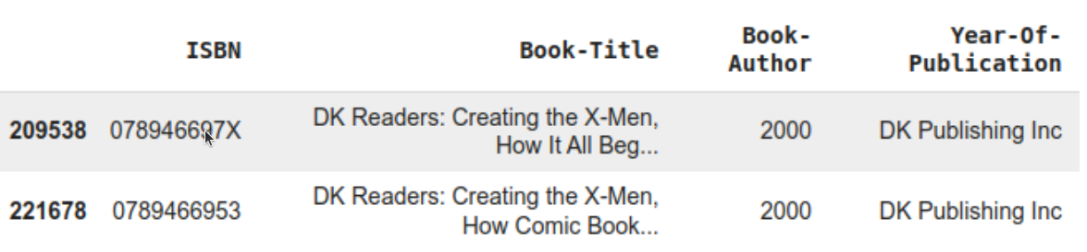
Data Preprocessing
Books Table:
There are some incorrect entries in the Year-Of-Publication field. It looks like Publisher names 'DK Publishing Inc' and 'Gallimard' have been incorrectly loaded as Year-Of-Publication in the dataset due to some errors in the csv file.
Here bookAuthor is incorrectly loaded with bookTitle, hence we have to make required corrections.
Same with exploring the Book-Author column, we found two missing values in the Book-Author Column, So we filled ‘other’ for NaN.

Slide 15
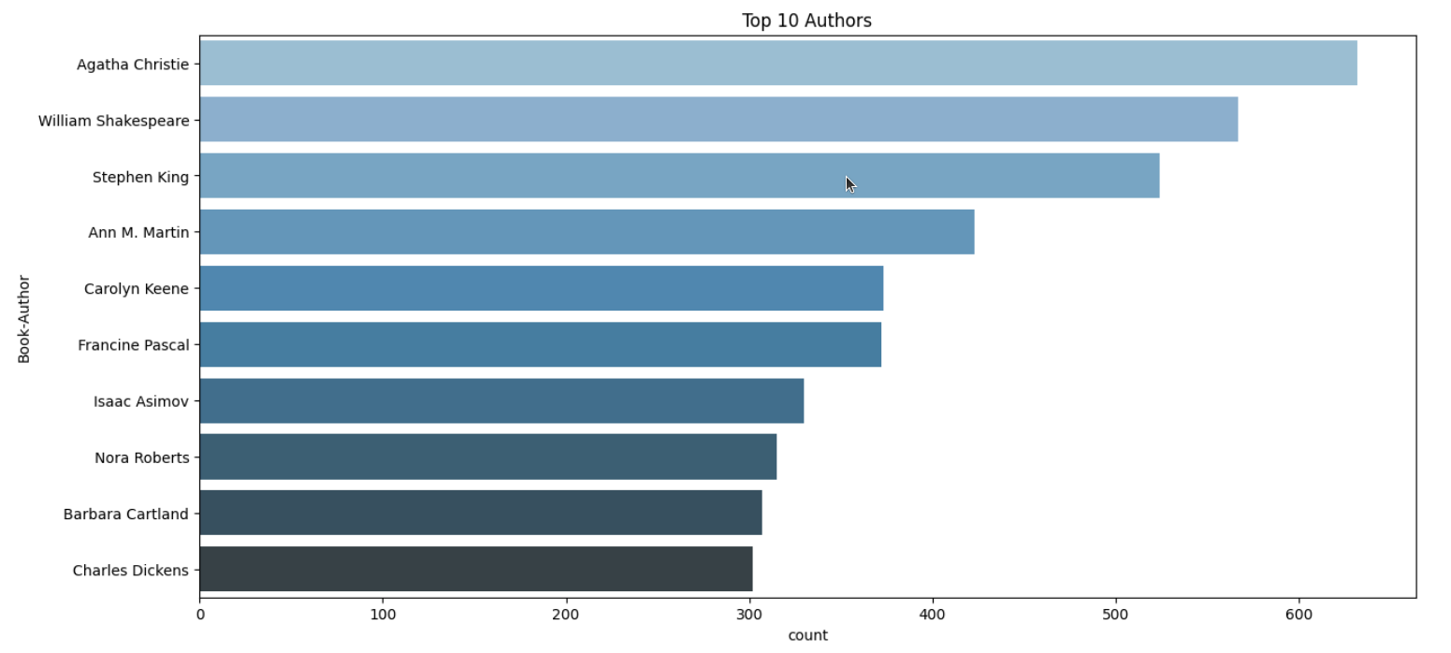
Data Preprocessing
Top 10 Authors which have written the most books

Slide 16
Implementation
Project Structure
The project is organized into a well-structured hierarchy, ensuring a clean separation of concerns and facilitating ease of development and maintenance. Below is an overview of the project structure:
Parent Directory
● app.py: This is the main application script that sets up the Flask server, defines routes, and handles HTTP requests. It is the entry point of the application.
● model.py: This script contains the BookRecommender class, which includes various functions for handling user data and generating book recommendations.
● CSV Files: All necessary data files (such as user ratings and book information) are stored directly in the parent directory. These files are loaded and processed by the application as needed.

Slide 17
Implementation
Templates Directory
This directory contains multiple HTML files, each corresponding to a different page of website. These templates are used to render dynamic content and provide a consistent layout across the application.
○ index.html: The homepage of the website.
○ about.html: Provides information about the project.
○ methods.html: Describes the various recommendation methods explored.
○ results.html: Displays the results and findings of the project.
○ demo.html: A live demo page where users can interact with the recommendation system.
○ contact.html: A page for user feedback and contact information.

Slide 18
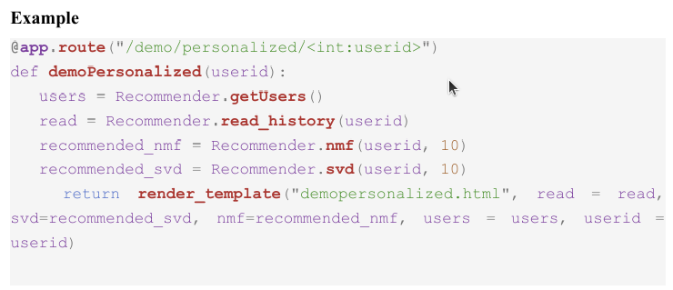
Implementation
Front-End Integration
The frontend of the book recommendation system is integrated with the backend using Flask to provide a seamless and dynamic user experience.
Dynamic Content Rendering
Flask's template rendering engine, Jinja2, is used to dynamically insert data into HTML templates.

Slide 19
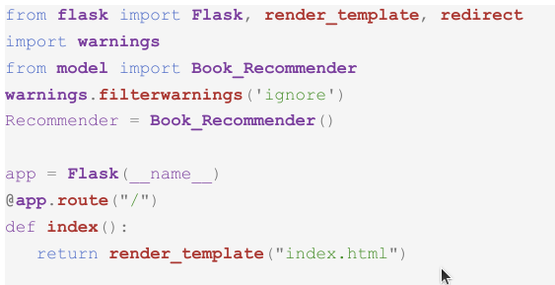
Implementation
Back-End Integration
The backend of the book recommendation system is implemented using Flask, a lightweight and flexible web framework for Python.
Index Route:
The index route serves the homepage of the website.

Slide 20
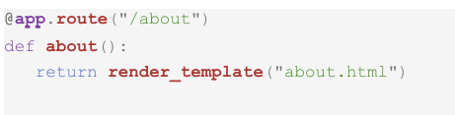
Implementation
Back-End Integration
The backend of the book recommendation system is implemented using Flask, a lightweight and flexible web framework for Python.
2. About Route:
The about route displays information about the project, including the motivation, goals, and team members involved.

Slide 21
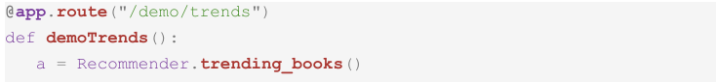
Implementation
Back-End Integration
The backend of the book recommendation system is implemented using Flask, a lightweight and flexible web framework for Python.
3. Demo/Trends Route:
The trends route showcases the trending books. It fetches the top trending books using the trending_books method from the BookRecommender class and displays them on the demo page

Slide 22
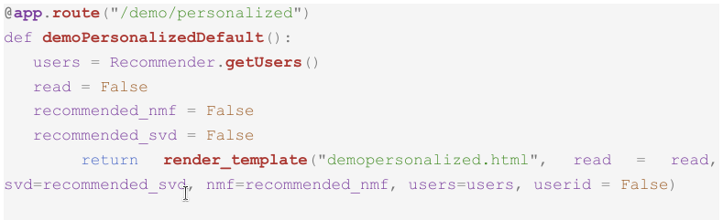
Implementation
Back-End Integration
The backend of the book recommendation system is implemented using Flask, a lightweight and flexible web framework for Python.
4. Demo/Personalized Route:
The personalized route allows users to see personalized book recommendations. It typically requires user identification to generate tailored recommendations.

Slide 23
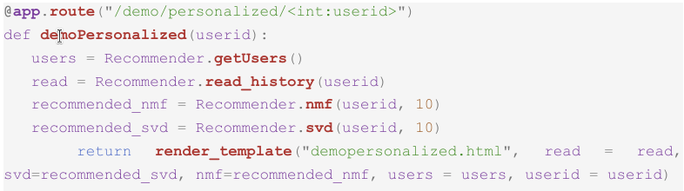
Implementation
Back-End Integration
The backend of the book recommendation system is implemented using Flask, a lightweight and flexible web framework for Python.
5. Demo/Personalized/UserID Route:
This route handles the personalized recommendations for a specific user. It uses the user ID to fetch recommendations via the nmf or svd method from the BookRecommender class.

Slide 24
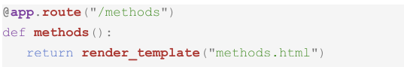
Implementation
Back-End Integration
The backend of the book recommendation system is implemented using Flask, a lightweight and flexible web framework for Python.
6. Methods Route:
The methods route describes the different recommendation algorithms explored in the project. It explains their strengths, weaknesses, and use cases.

Slide 25
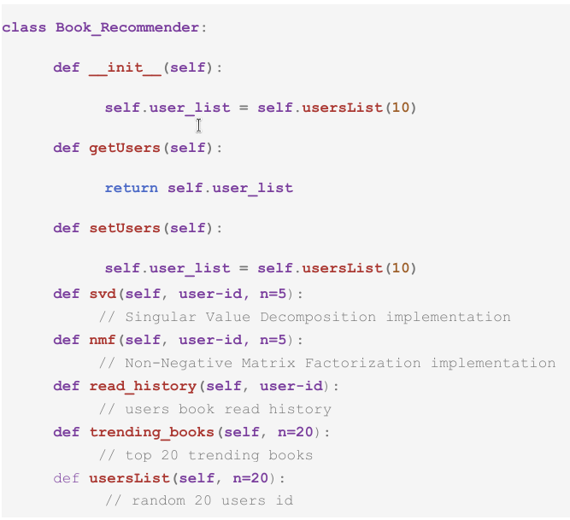
Implementation
BookRecommender Class:
The BookRecommender class in model.py encapsulates the core functionalities of the recommendation system. Here is a brief overview of the class:

Slide 26
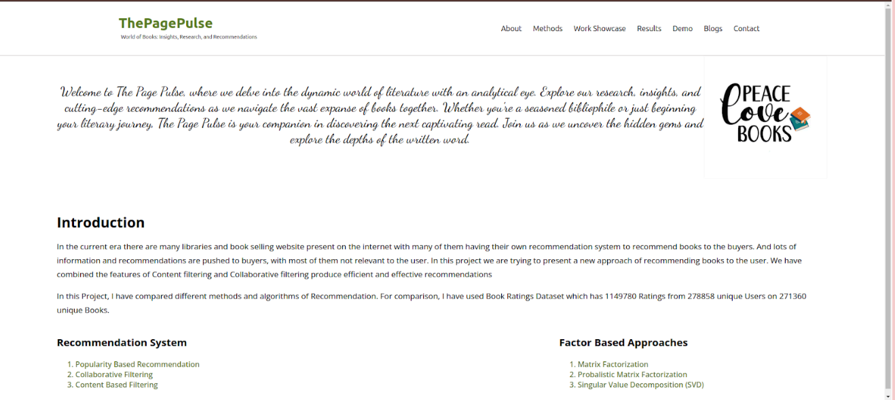
Glimpse of Website
/home

Slide 27
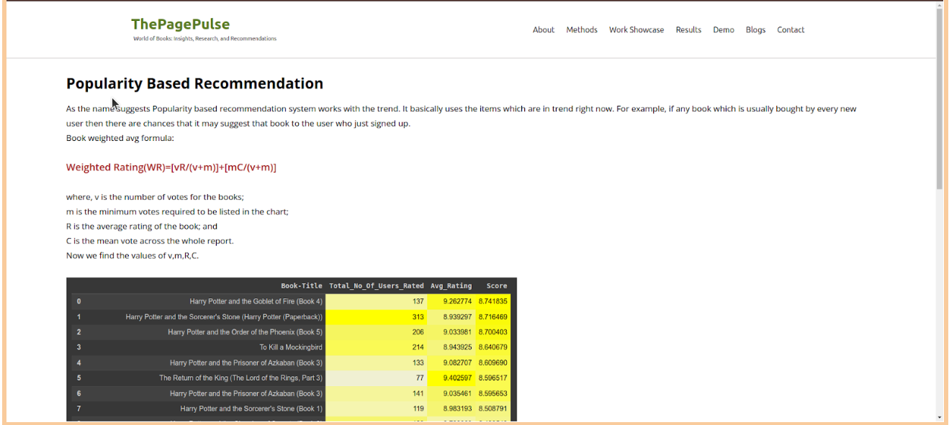
Glimpse of Website
/methods

Slide 28
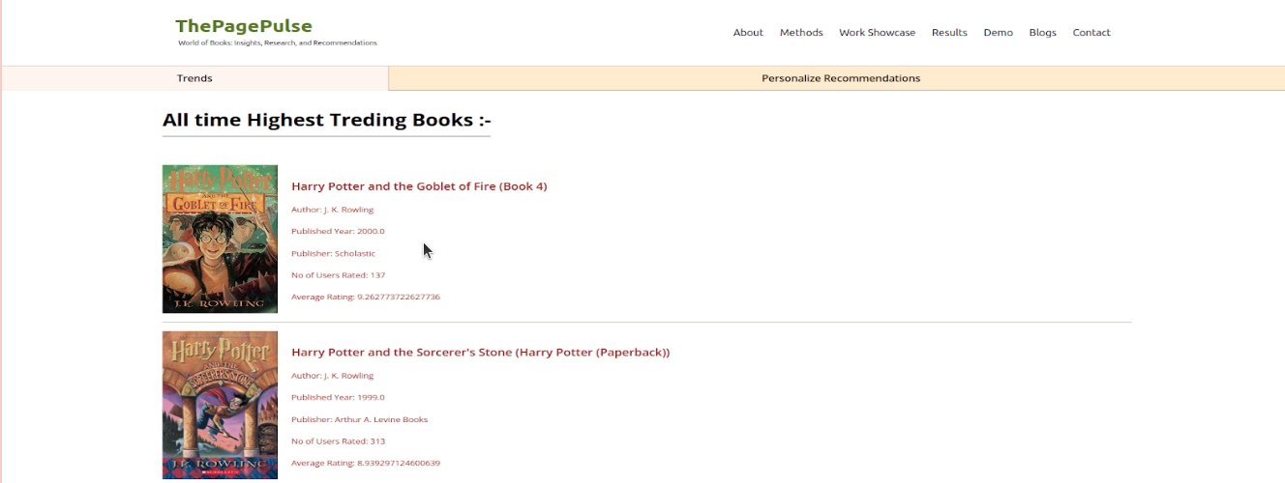
Glimpse of Website
/personalized/trends

Slide 29
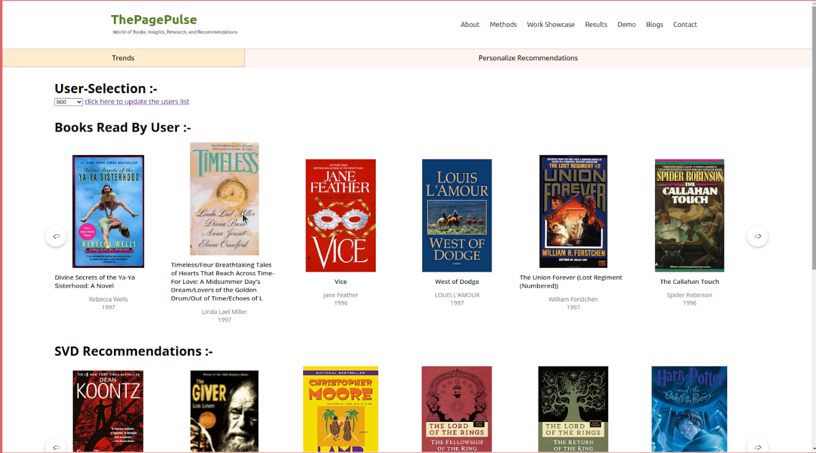
Glimpse of Website
/personalized/userID

Slide 30
Algorithm Development Process
Popularity Based Filtering
Popularity based recommendation systems work with the trend. It basically uses the items which are in trend right now.
Book weighted average formula:
Weighted Rating(WR) = [vR/(v+m)]+[mC/(v+m)]
Where,
V is the number of votes for the books,
M is the minimum votes required to be listed in the chart,
R is the average rating of the book; and
C is the mean vote across the whole report

Slide 31
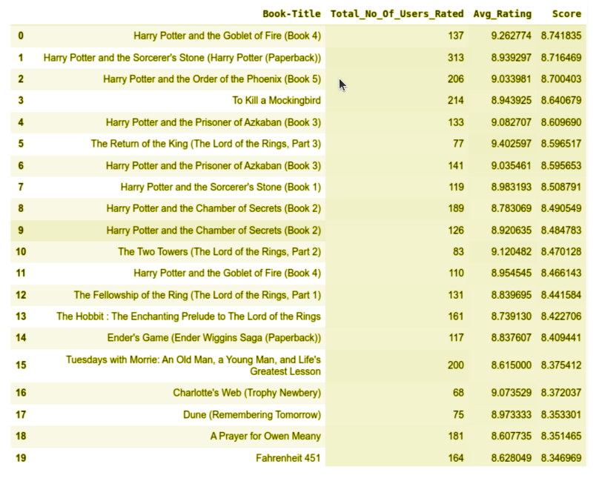
Algorithm Development Process
Popularity Based Filtering
Result after applying the Popularity based Filtering

Slide 32
Algorithm Development Process
User Based Collaborative Filtering
Train-Test Split
We will be using the train_test_split function of model_selection class from scikit-learn to create the train test dataset. Train test split 80 : 20 with training set length : 307073 and test set length : 76769.

Slide 33
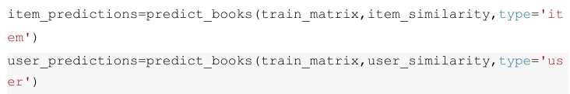
Algorithm Development Process
User Based Collaborative Filtering
Calculating the cosine similarity
To calculate the cosine distance we have used the pairwise_distances from metrics.pairwise class of the scikit-learn framework. To make Item-Item similarity we need to take the the transpose of the matrix

Slide 34
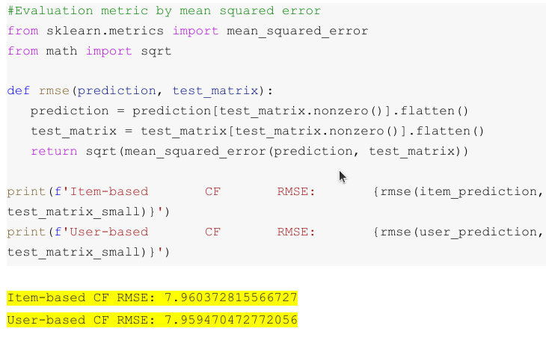
Algorithm Development Process
User Based Collaborative Filtering
Evaluation Metric
We have used MSE (Mean Squared
Error) as the evaluation metric

Slide 35
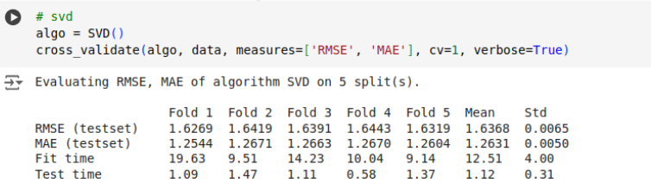
Algorithm Development Process
Singular Value Decomposition
We are using a python framework ‘surprise’ for SVD implementation.
model_svd = SVDpp() model_svd.fit(trainset)
On evaluation we found the SVD’s RMSE (root mean squared error) and MAE (mean absolute error) are 1.6368 and 1.2631 respectively.

Slide 36
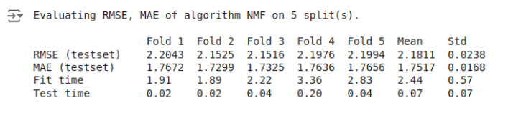
Algorithm Development Process
Non-Negative Matrix Factorization
model_nmf = NMF()
model_nmf.fit(trainset)
NMF’s RMSE and MAE scores are 2.1811 and 1.7517 respectively

Slide 37
Algorithm Development Process
Non-Negative Matrix Factorization
model_nmf = NMF()
model_nmf.fit(trainset)
NMF’s RMSE and MAE scores are 2.1811 and 1.7517 respectively

Slide 38
Algorithm Development Process
Non-Negative Matrix Factorization
model_nmf = NMF()
model_nmf.fit(trainset)
NMF’s RMSE and MAE scores are 2.1811 and 1.7517 respectively

Slide 39
Conclusion
There are millions of books in the entire world wide and people need some instructions to find the appropriate book. Making decision and scrolling for the right book from millions of books can be hard and a complete waste of time. To compete and keep up in the market, some viewers may just rate the book in unbiased form. The use of such overstated descriptions is misleading the viewers to unpromising products or books

Slide 40
Reference Paper: [1] Ashish Fatarphekar, Tejas Nashikkar, Vivek Patil, Gayatri Naik, “BOOK RECOMMENDATION SYSTEM BASED ON COMBINE FEATURES OF CONTENT BASED FILTERING, COLLABORATIVE FILTERING AND ASSOCIATION RULE MINING”, 2015, Advance Research in Social science and Humanties (ISSN: 2208-2387) [2] Ms. Praveena Mathew, Ms. Bincy Kuriakose, Mr.Vinayak Hegde, “Book Recommendation System through Content Based and Collaborative Filtering Method”, 2016, Department of Computer Science Amrita Vishwa Vidyapeetham Mysuru Campus Mysuru, Karnataka, India [3] Madhuri Kommineni, P.Alekhya, T. Mohana Vyshnavi, V.Aparna, K Swetha, V Mounika, “Machine Learning based Efficient Recommendation System for Book Selection using User based Collaborative Filtering Algorithm”, 2020 [4] Ashlesha Bachhav, Apeksha Ukirade, Nilesh Patil, Manish Saswadkar, Prof. Nitin Shivale, “Book Recommendation System using Machine learning and Collaborative Filtering”, 2022, IJARSCT

Slide 41
Thank You

